Slide 1
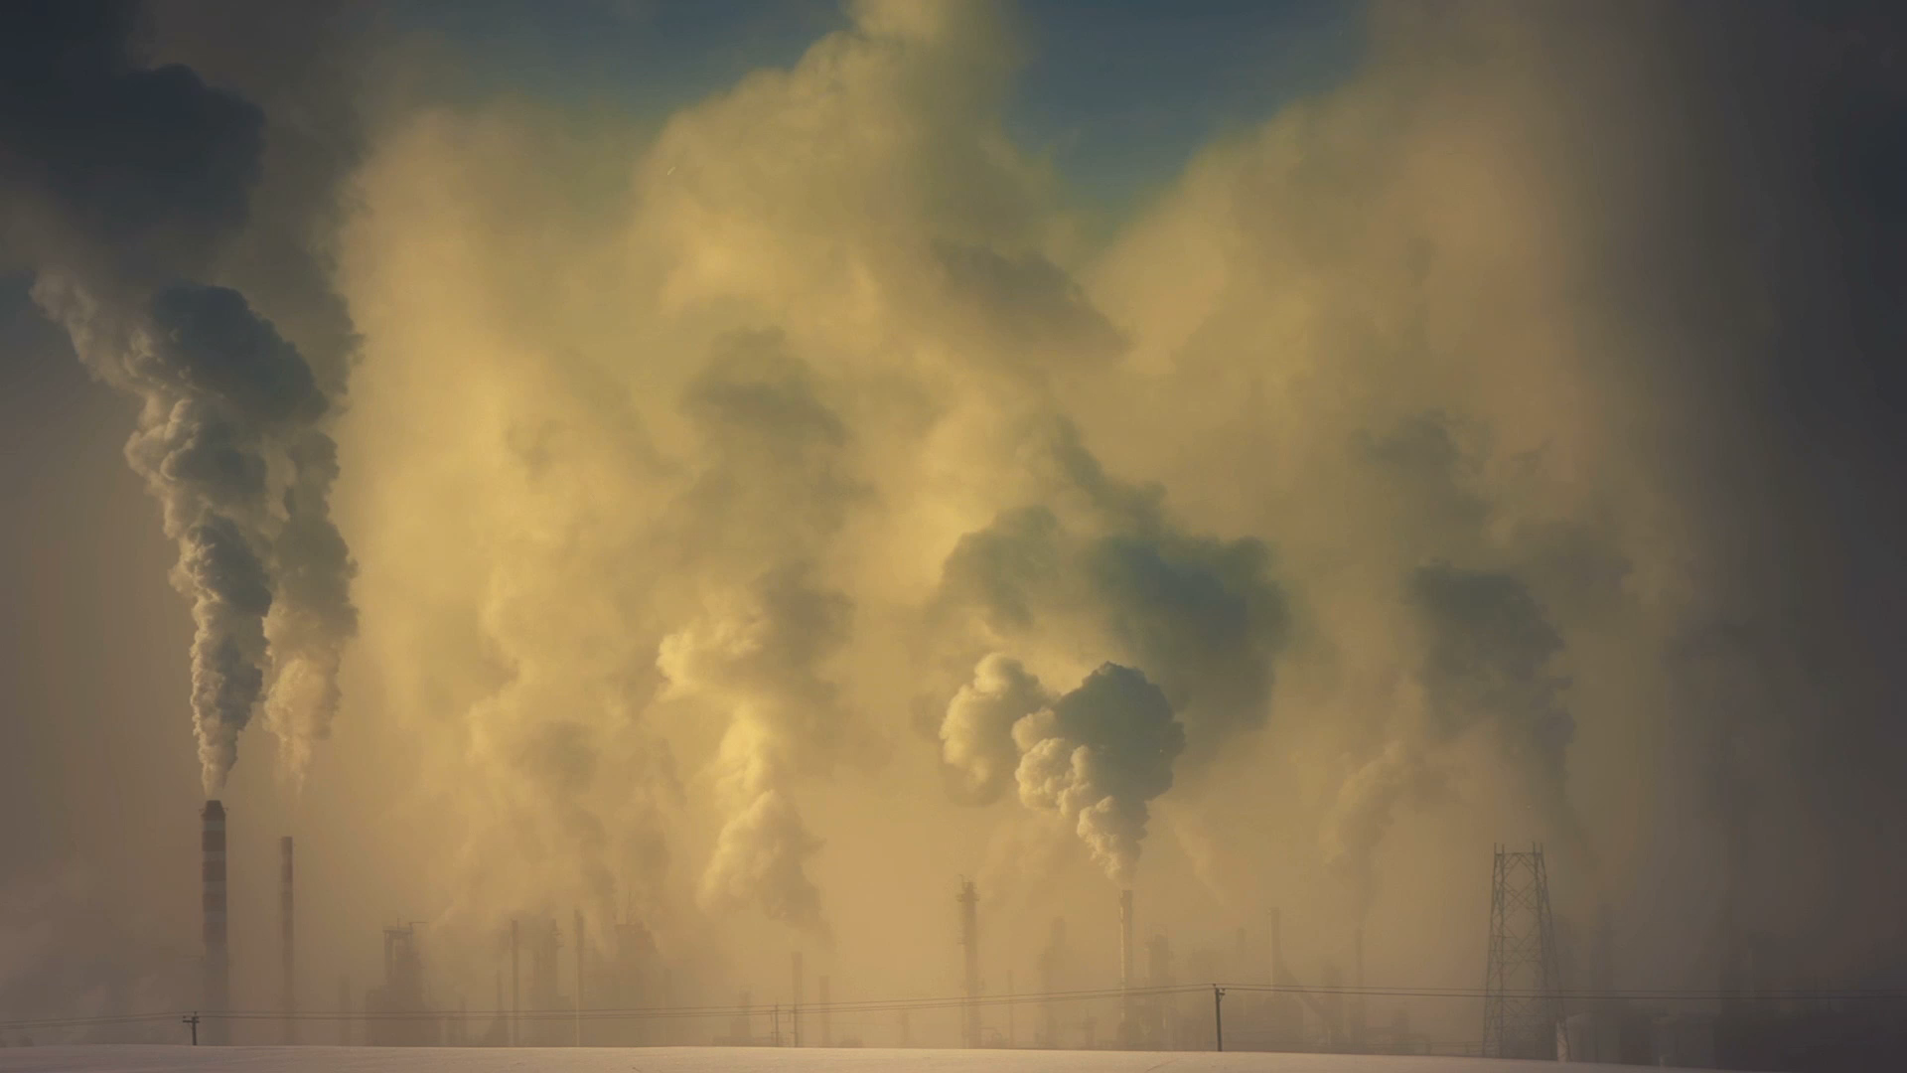
CO2 Emission Trends
Lesly Boulos
Violet Huang
Jonathan Martin
Michel Angel
Das Deepam

Slide 2
Structure
1) Data Exploration
2) Analysis
3) Data Visualization
4) Conclusion

Slide 3
Data Exploration
Dataset provided by CICERO Center for International Climate Research
CO2 Emissions (MtCO2) from coal, oil, gas, cement, flaring, and other sources, as well as emissions per capita, are all included in this dataset

Slide 4
Data Cleaning
The dataset provided was cleaned and it was ready to be used for analysis. However, some cleaning was still done to properly used the data such as:
All rows except “global” were removed to analyze the global trend of CO2 and to come out with predictions.
All rows except 2021 year was shown to analyze the 2021 biggest polluters.
All rows except 2000 year was shown to analyze the 2020 biggest polluters.
All rows except 1980 year was shown to analyze the 1980 biggest polluters.

Slide 5
Goals
Goals:
The global CO2 emission trend - to see if the Paris Accord 2030 goal of CO2 emission could be reached. The Paris Accord states that the goal for emission should be at least a 40% reduction by 2030 compared to 1990 CO2 levels.
Statistical Analysis to find the countries that contributed the most to global CO2 emissions

Slide 6
Analysis
Linear Regression
Top 3 Polluters (2021)
Unsupervised Machine Learning
Deep Neural Network

Slide 7
Linear Regression
Linear Regressions were made for 4 different timeframes
1750-2021
1900-2021
2000-2021
1980-2021

Slide 8
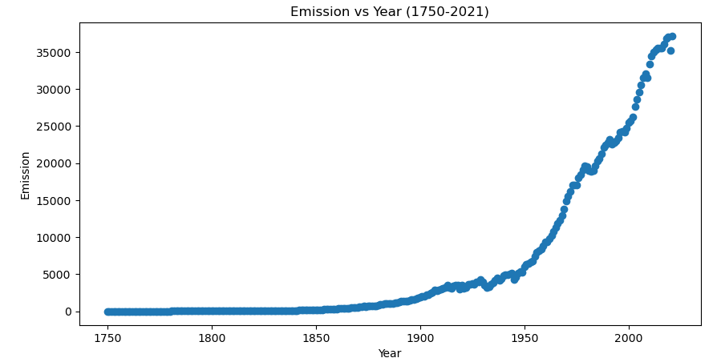
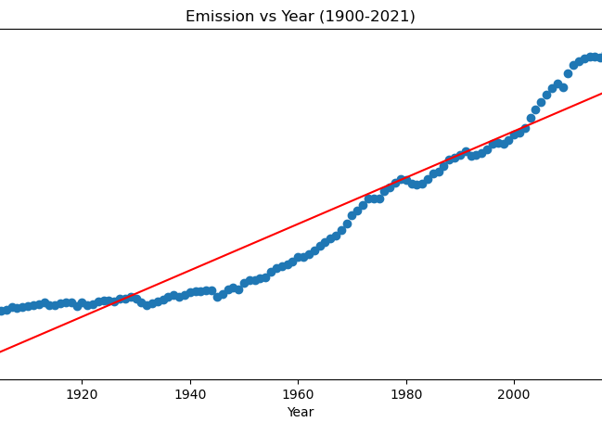
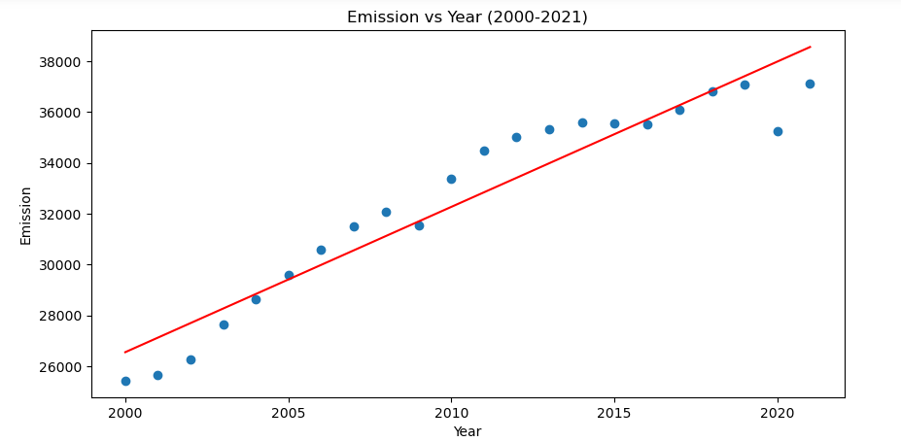
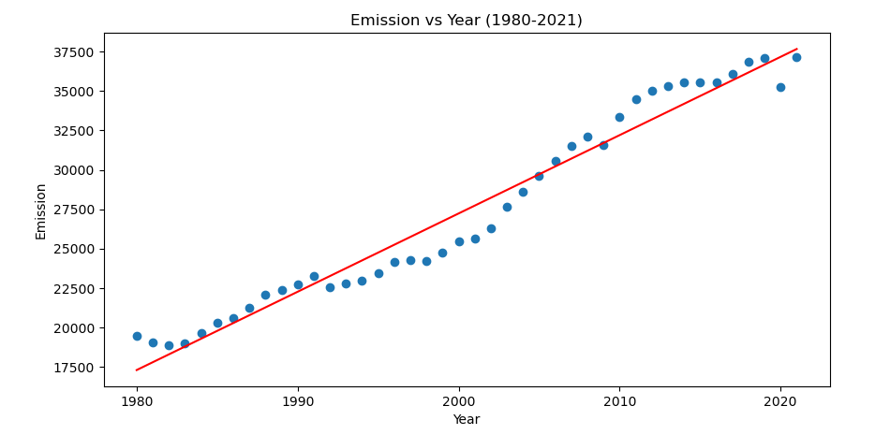
Timeframes Comparison
Exponential Regression Needed

Slide 9
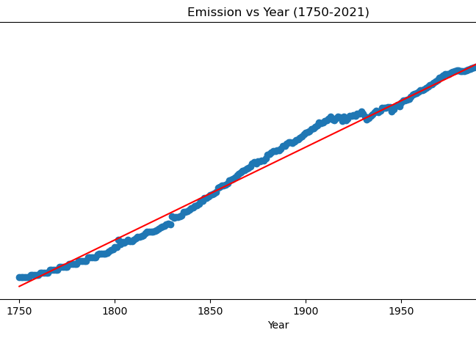
Timeframes Comparison
R2=0.987
R2=0.907
R2=0.914
R2=0.964

Slide 10
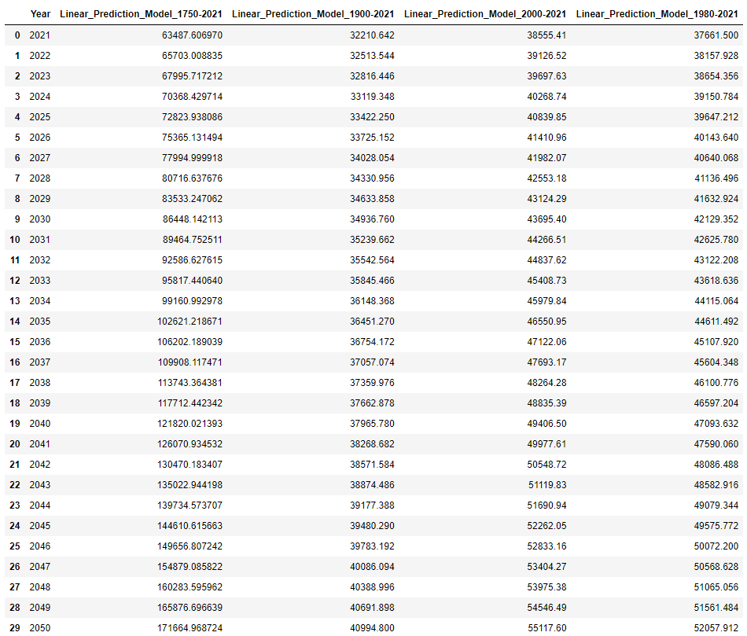










Prediction Model Results
Actual Emission in 2021 per our dataset : 37,1123.85 MtCO2
The 2000-2021 and 1980-2021 quite close in terms of predictions, signs of a constant growth rate for the last 40 years.

Slide 11
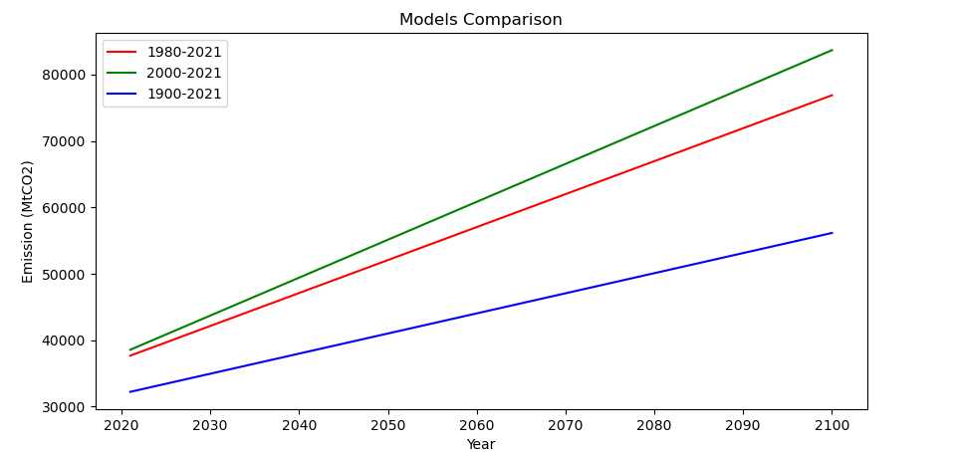
Model Comparison (Removing Outlier)
1) Since 1900 the emission growth rate has drastically increased, and our predicted emission shifted upward over the years. This is apparent looking at the 2021 year where the actual CO2 emission quantity is much larger than the predicted forecast of the '1900-2021' trend.
2) The graphs shows that the emission level does seems to want to plateau in term of growth rate. This is evident since the 1980-2021 and 2000-2021 models are very close in term of predictions.
3) All graphs shows that the CO2 level will keep increasing with the current global emission rate. This is true for all 3 predictions. Hence, we will not meet the Paris Accord Goal of around ~16000 MtCO2 by 2030 (assuming same trend).

Slide 12
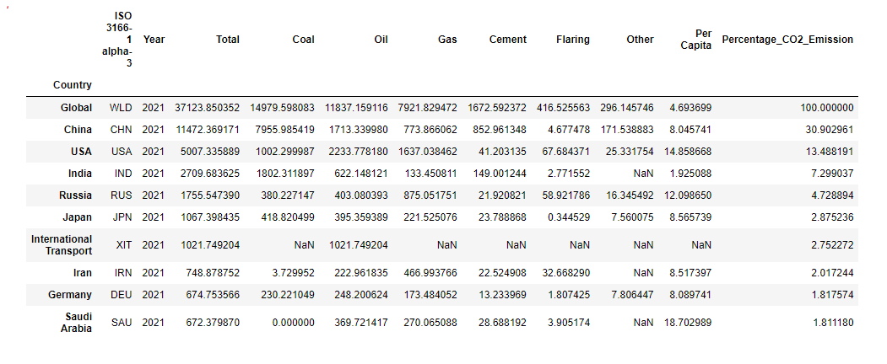
Top 3 Polluters (2021)
Based on our dataset : China (30.9%), USA (13.5%), India (7.3%) are the world biggest polluters. These 3 countries emitted more than 51.7% (19189 MtCO2) of all global CO2 in 2021.

Slide 13
Unsupervised Machine Learning
The dataset provides detailed emissions level by country for over 200 years. This can give us an insight into how each country's emission level changes over the course of history.
By grouping countries together, we can identify large emitting countries quickly and target them to reduce emissions the most. For this task, we utilized unsupervised learning techniques, specifically K-means clustering. We focused on 1970, 2000, 2021.

Slide 14
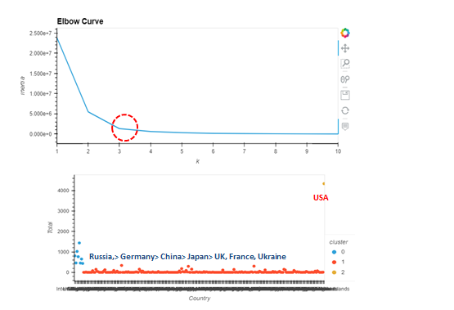
Unsupervised ML 1970

Slide 15
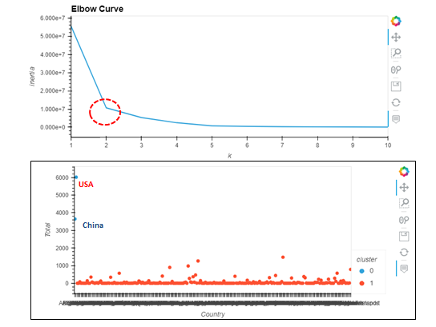
Unsupervised ML 2000

Slide 16
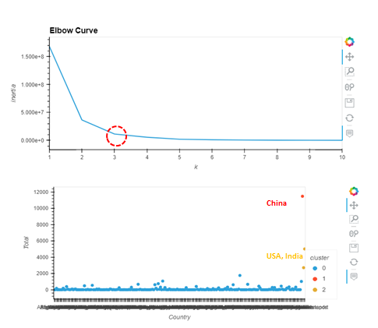
Unsupervised ML 2021

Slide 17
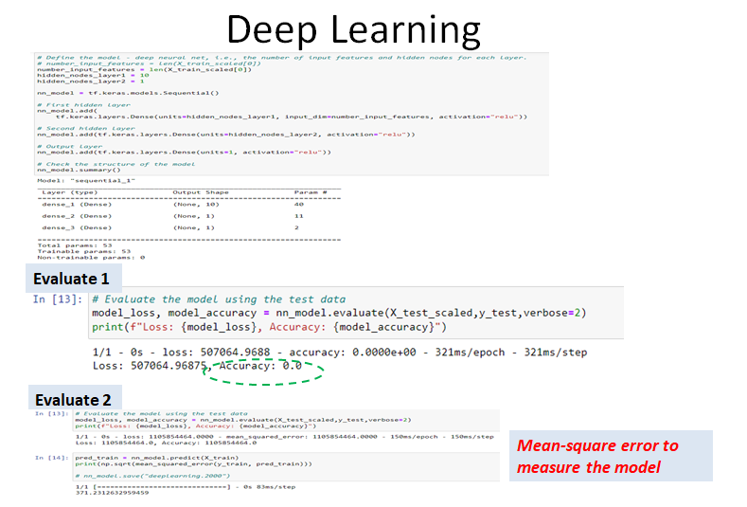
Deep Neural Network
Deep neural networks can learn from large sets of input data, regardless of data complexity. We wanted to explore deep neural networks to see if it's a good use case for our dataset as well.
Not a good fit because it does not work on continuous data

Slide 18
Data Visualization
Country emission by year
Country emission by trend (1750-2021)
Global Prediction

Slide 19
Conclusion
The Paris climate accord goal of CO2 emission will not be reached based on the current levels of global emissions. Hence by 2030 we will not reach a 40% CO2 emission reduction rate compared to the 1990's level. Assuming the emission trend remains the same, the linear regression analysis shows the CO2 emission will keep increasing to about 42129 MtCO2 in 2030. Almost triple the target rate set for 2030 (~16000 MtCO2).
In 2021, based on our dataset, China (30.9%), USA (13.5%), India (7.3%) are the world biggest polluters. These 3 countries emitted more than 51.7% (19189 MtCO2) of all global CO2. By performing K-means clustering at five-year intervals. We saw the trend of how large emitting countries change throughout history. As history tells us, the largest emitters in 1970 were the USA, as well as in 2000, and eventually they were surpassed by China in 2021, with India close behind.
One other model was performed 'deep neural network'. However, it was not a good fit for our analysis since it was focusing on classification and not prediction. Our data is continuous.

